Slide 1


DEFECT DETECTION MODEL
SUPERVISED BY
DR. AHMED SHAWKY MOUSSA
TA. ANDREW MAHER
IMPLEMENTED BY
AHMED GAMAL 20190021
AHMED ADEL 20190042
HASNAA MOUNIR 20190180
ZEYAD MAHER 20190224
MENNATULLAH RASHED 20190554
Graduation Project
Academic Year 2022-2023
Midyear Short Documentation

Slide 2
TABLE OF CONTENTS
01
02
03
Project idea
Problem significance
Project specifications
04
05
06
Project implementation
Summary
Project Timeline

Slide 3
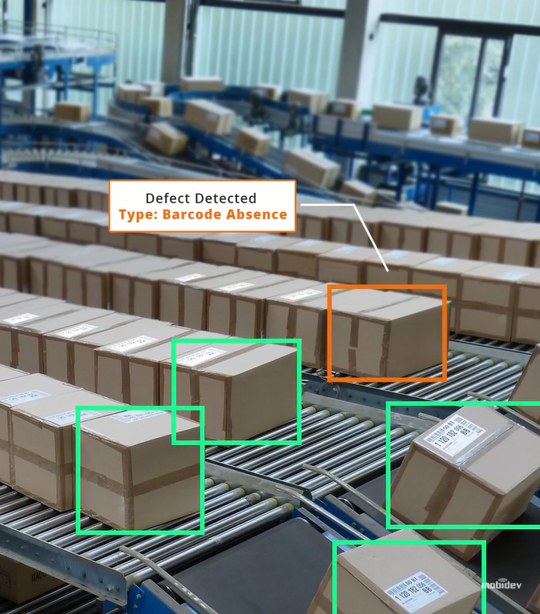
01
PROJECT IDEA
1

Slide 4
Introduction
As the American Society of Quality reports [1], many organizations have quality-related costs of up to 40% of their total production revenue.
This has led to the integration of AI in the field, as human beings have limited ability to detect manufacturing defects and subtle errors.
[1]
https://asq.org/quality-resources/cost-of-quality#:~:text=Many%20organizations%20will%20have%20true,10%2D15%25%20of%20operations.
2

Slide 5
Project Idea
MISSION
VISION
developing a more efficient and accurate way of defect detection model.
developing software that can scan products and validate their quality.
IDEA
SCOPE
By inputting a video and breaking it into frames, each frame can be analyzed using AI to detect any defects present.
the manufacturing industry where ensuring product quality is crucial to success.
3

Slide 6






Domain of Interest
Deep Learning.
Computer Vision.
Python
tensorflow
Image processing.
Flutter
Google Colab
Android studio
4

Slide 7

02
Problem significance
5

Slide 8
The problem we are going to solve
Defects in manufacturing have negative effects on manufacturers and end users, making them undesirable.
Decreased efficiency
Wasted resources
Lost
profits
Reduced
quality
company's reputation
6

Slide 9

The previous solutions to the problem
Manual quality inspection is an important step in ensuring the success and sustainability of a business.
Subjectivity
High cost
Upskill employees
Review workflow
Hire more workers
Time consuming
Prone to human error
Limited scalability
7

Slide 10

The previous solutions to the problem
MobiDev: Concrete Crack Detection with Unsupervised ML.
It is unsupervised model. It’s required human intervention, and The results often have lesser accuracy.
ML defect detection model in selective laser sintering based on CNN.
More expensive.
Autonomous Detection, Classification and Localization of Road Defects.
It is a similar AI model that uses CNN, but it is for another application; Road Defects.
8

Slide 11
How should we solve this problem?
One application with a big potential to benefit from AI – computer vision is quality control.
Speed
Quality
Cost
Localization
9

Slide 12
03
Project specifications
10

Slide 13
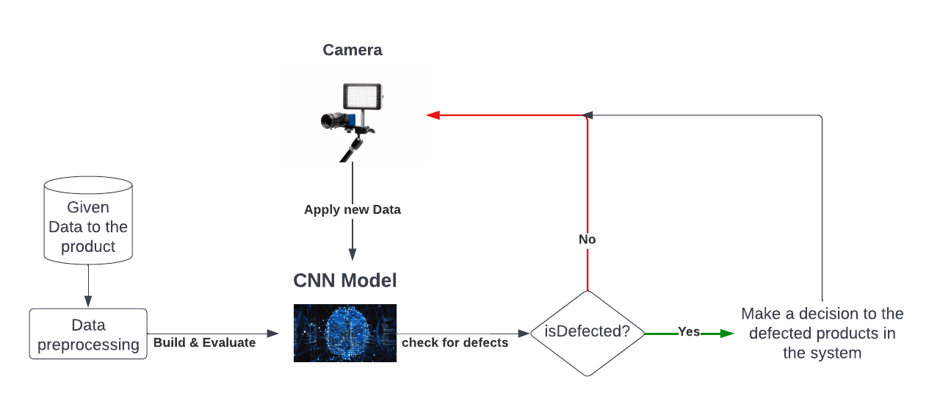
3.1. System Architecture
11

Slide 14
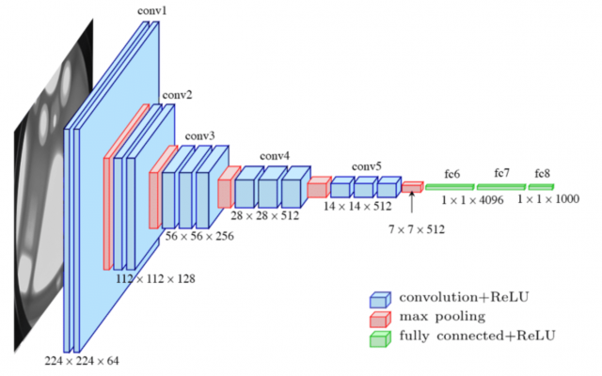
3.2. CNN Architecture
Visual Geometry Group (VGG-16)
VGG is considered one of the best CNN Architectures for classification
using 13 Convolution + 3 fully connected + 5 max-pooling layers
12

Slide 15
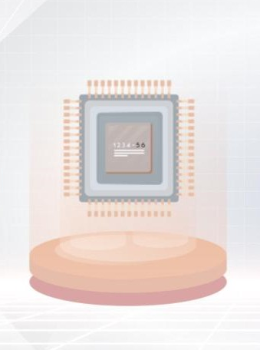
Stakeholders
Factory Owner and Worker
Team Members
and Project
Owner
Product Expert
13

Slide 16
Project Requirements
Functional Requirements
Non-Functional Requirements
Detecting Defective products.
Real-time Analyzing.
Giving a Feedback to the user.
High performance
Usability
Scalability
14

Slide 17
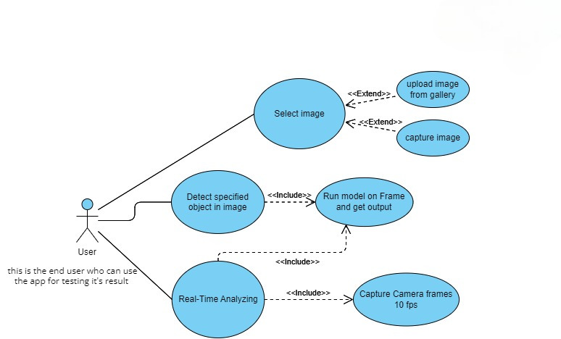
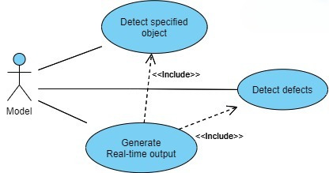
3.4. Use Case Diagrams
User
Model
15

Slide 18
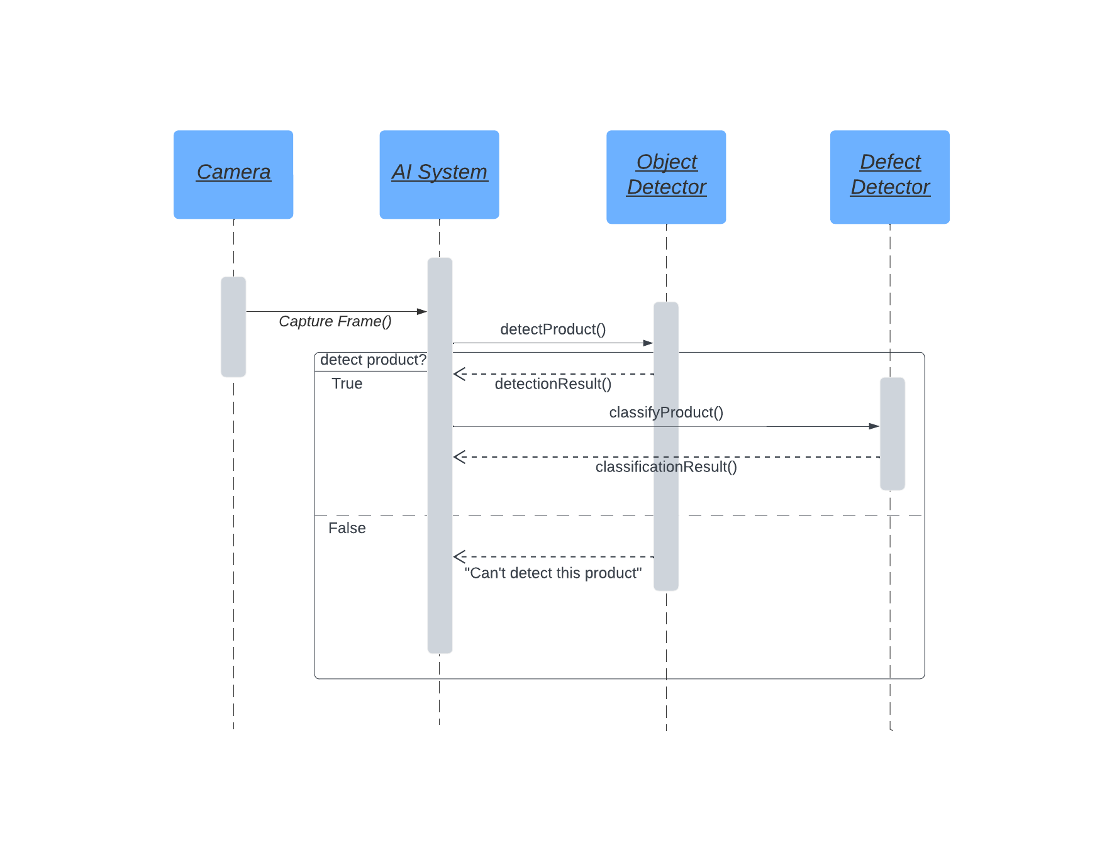
3.5. Sequence Diagram
16

Slide 19
04
Project implementation
17

Slide 20
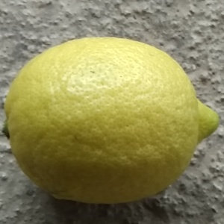
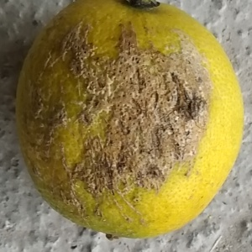
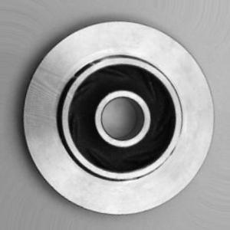
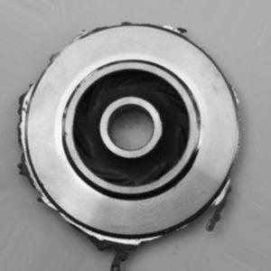
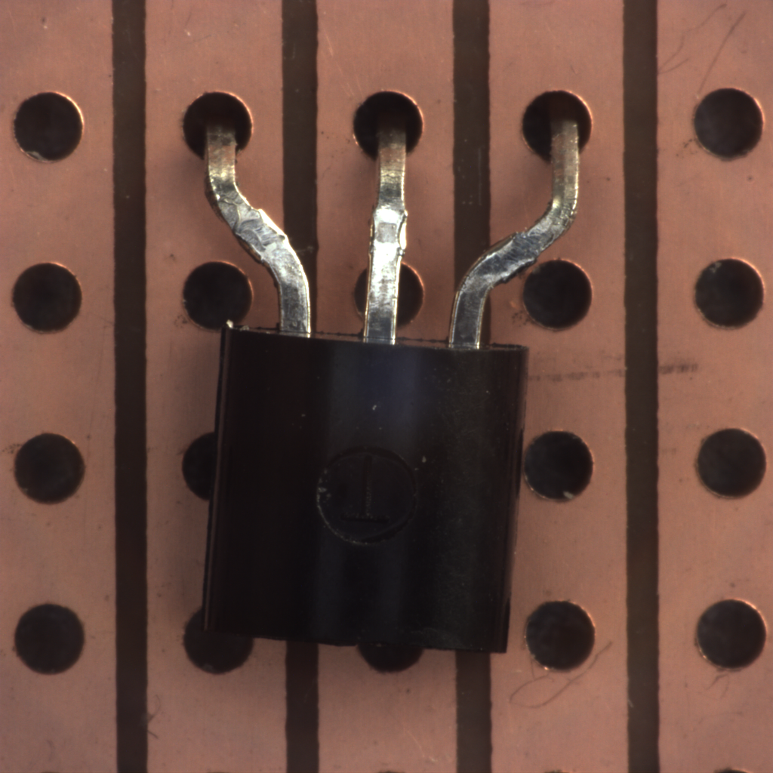
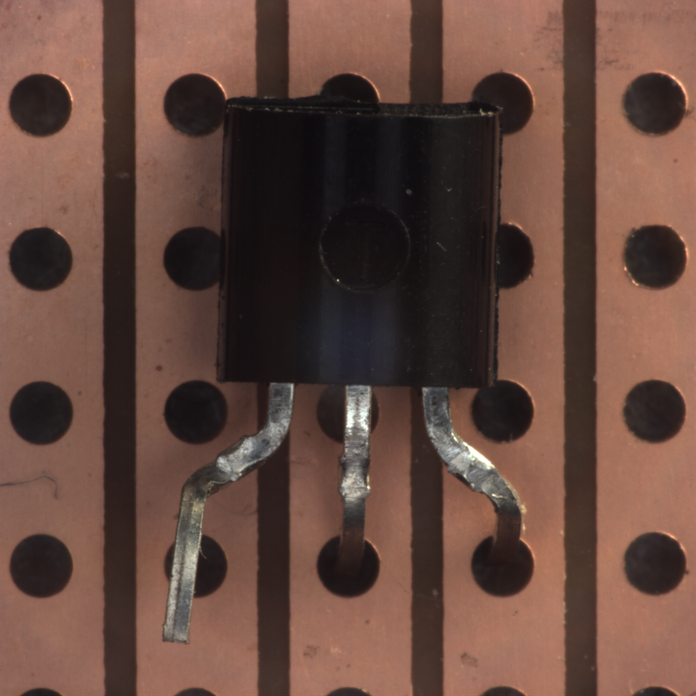
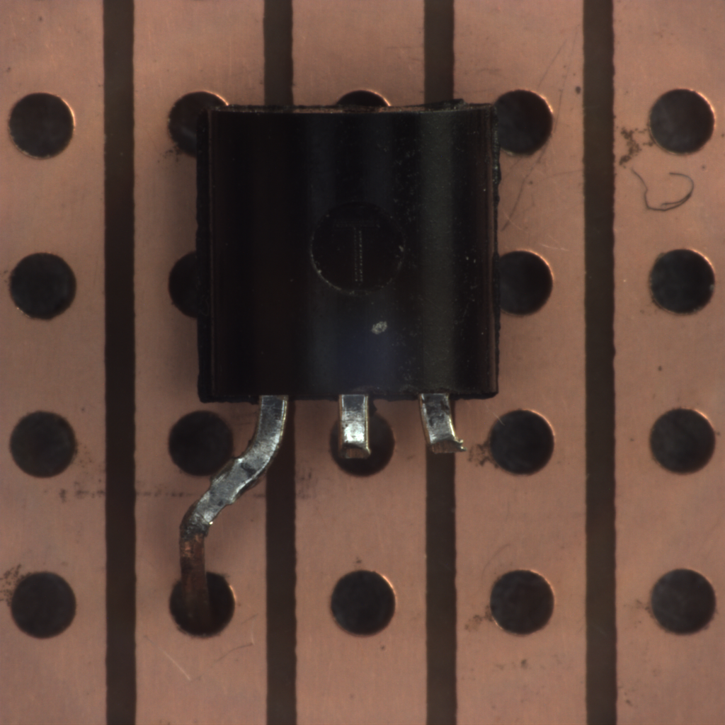
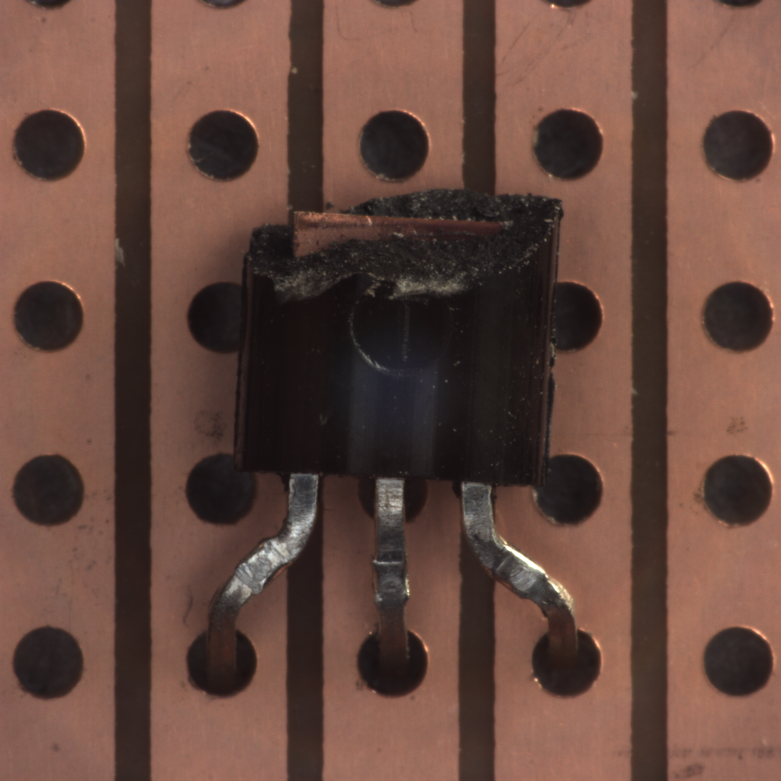
Datasets
Lemon
1,000 pics
GOOD
BAD
Iron Stamps
10,000 pics
Transistor
250 pics
GOOD
Defected
misplaced
bent
cut
damaged
18

Slide 21
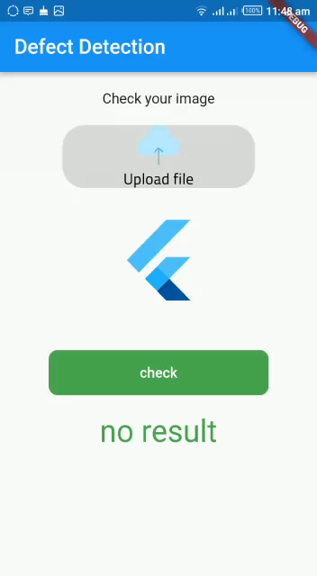
What about results?
19

Slide 22
04
Project Timeline
20

Slide 23
Project Timeline
Done
To Do
August
January
Jupiter is the biggest planet
Neptune is the farthest planet
September
February
Saturn has several rings
Pluto is now a dwarf planet
October
March
Neptune is the farthest planet
Earth is where we live on
November
April
Pluto is now a dwarf planet
Mercury is the smallest planet
December
May
Neptune is the farthest planet
Earth is where we live on
21

Slide 24
06
Summary
22

Slide 25

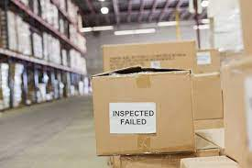

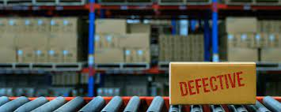
Summary
It can not be eliminated through the industrial process.
The best approach to address this problem is to prevent defective units from entering the market to maintain a high-quality rate.
23

Slide 26
Our next steps
As a result, our aim for the next period planned so far is:
Accuracy
Flexibility
optimizing the model to get the highest accuracy we can achieve.
Making the model flexible to handle all potential cases in the workplace.
Research
Utility
Researching the domain of application for the model.
Outlining the limitations of the model and when it loses its utility
24

Slide 27
THANKS!
Do you have any questions?
Ahmed.addel.48@gmail.com
Ahmed291.ag@gmail.com
zeyadmaher638@gmail.com
mennatullahrashed12@gmail.com
hassnaamoner79@gmail.com

